Slide 1
Covid Data in the US
By Quinn Agabob

Slide 2
Research Question
Research Question: Are different areas of US affected differently by COVID-19?
Metrics:
State
Region
Cases/population
Mortality rate

Slide 3
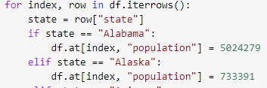



Data Engineering
DATA I need
Population
Take in a dataset of covid data in the us
date(change to datetime)
state(Full Name)
fips(will be dropped)
Cases
Deaths
Region
Abbreviation

Slide 4
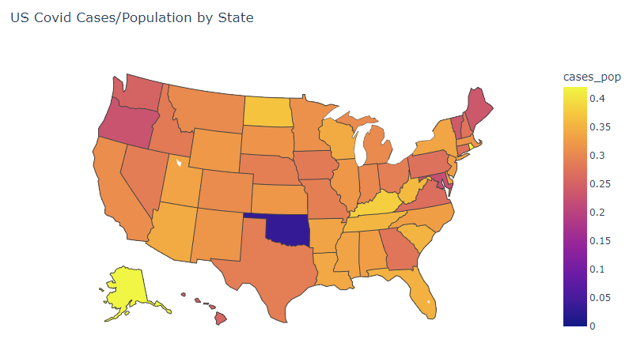
Graph #1: Choropleth graph of Cases/Population by state
Used Ploty Express

Slide 5
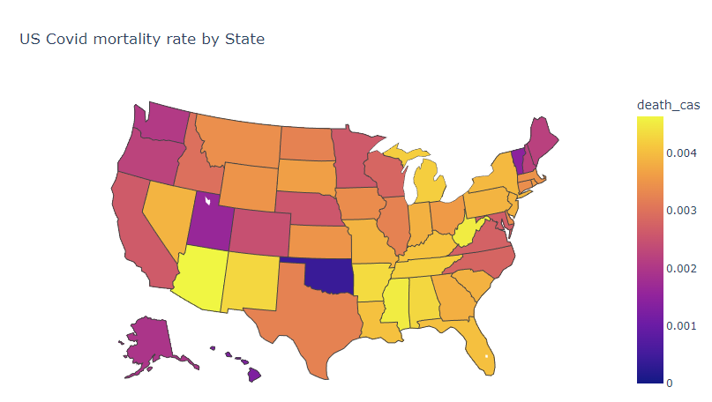
Graph #2: Choropleth graph of Deaths/Cases by state

Slide 6
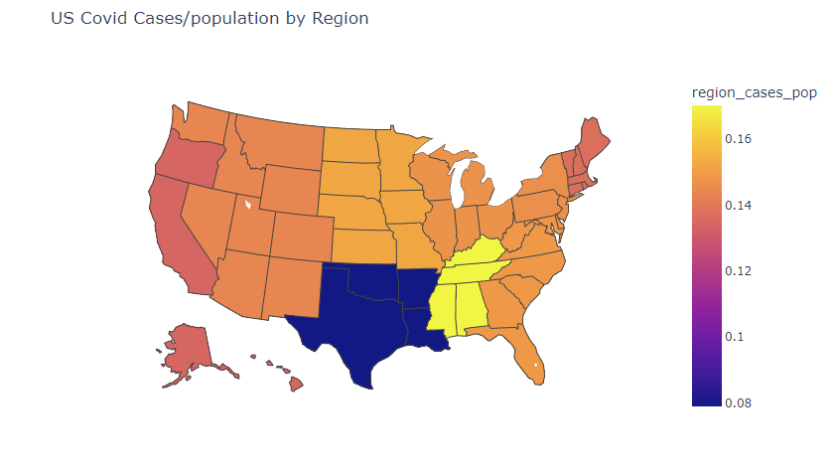
Graph #3: Choropleth graph of Deaths/Cases by region

Slide 7
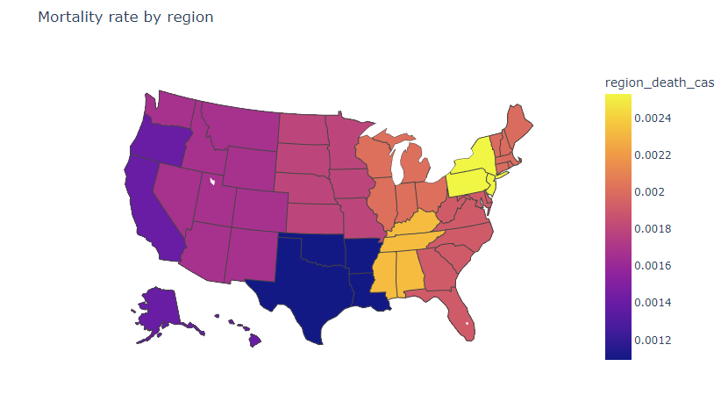
Graph #4: Choropleth graph of mortality rate by region

Slide 8
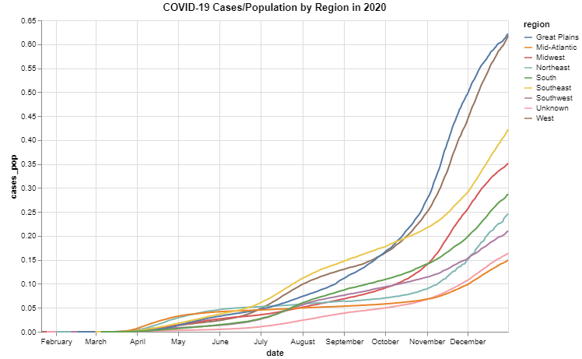
Graph #5: stacked line graph of Covid-19 cases/population by region in 2020

Slide 9
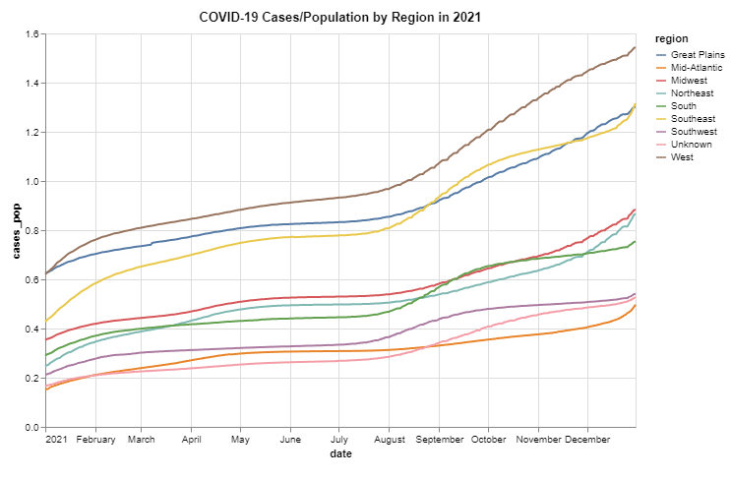
Graph #5: stacked line graph of Covid-19 cases/population by region in 2021

Slide 10
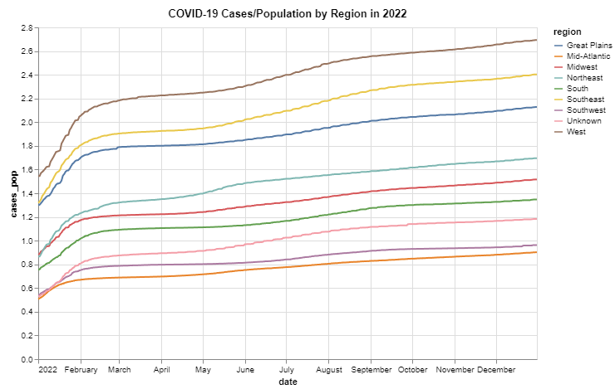
Graph #5: stacked line graph of Covid-19 cases/population by region in 2022

Slide 11
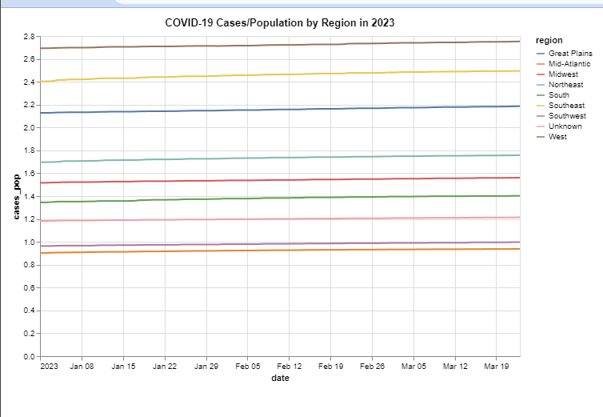
Graph #5: stacked line graph of Covid-19 cases/population by region in 2023

Slide 12
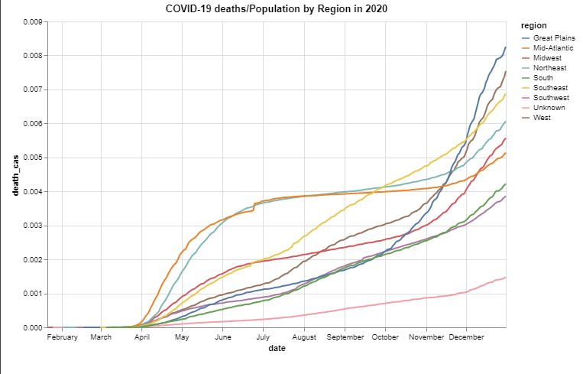
Graph #6: stacked line graph of Covid-19 deaths/cases by region 2020

Slide 13
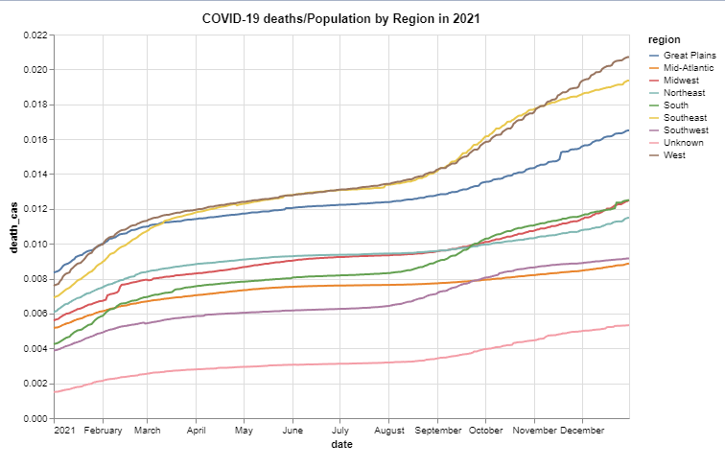
Graph #6: stacked line graph of Covid-19 deaths/cases by region 2021

Slide 14
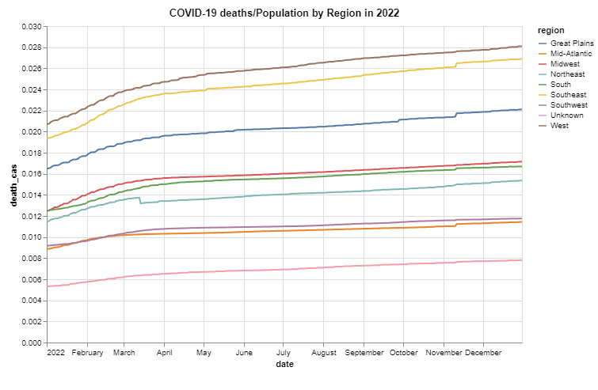
Graph #6: stacked line graph of Covid-19 deaths/cases by region 2022

Slide 15
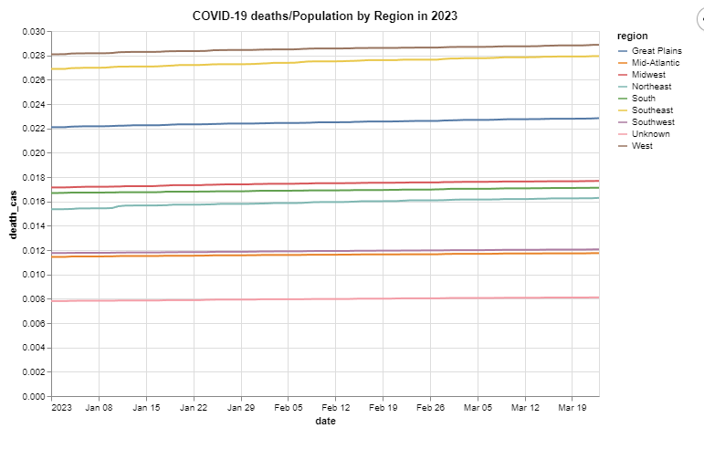
Graph #6: stacked line graph of Covid-19 deaths/cases by region 2023

Slide 16
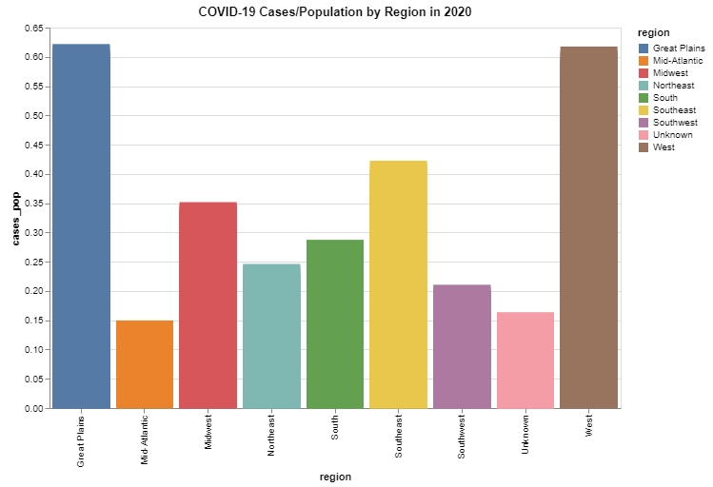
Graph #7: Histogram of Covid-19 deaths/cases by region 2022

Slide 17
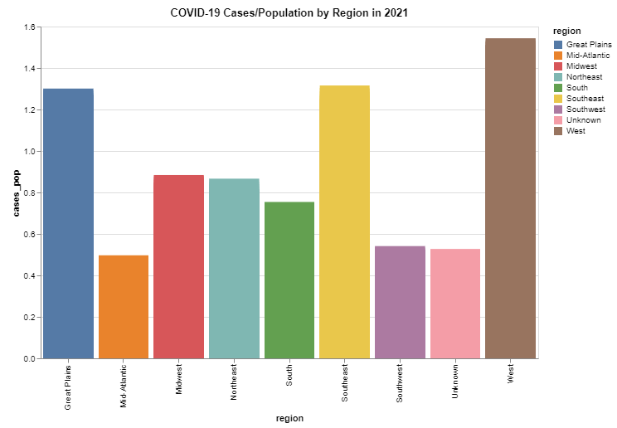
Graph #7: Histogram of Covid-19 deaths/cases by region 2021

Slide 18
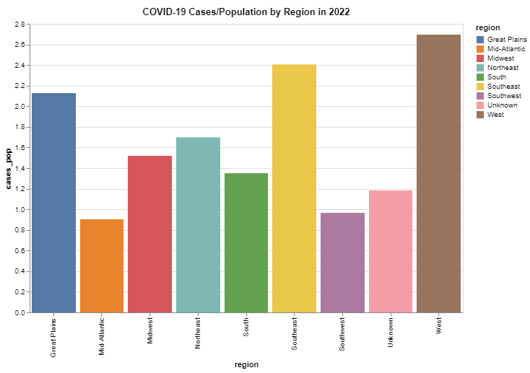
Graph #7: Histogram of Covid-19 deaths/cases by region 2022

Slide 19
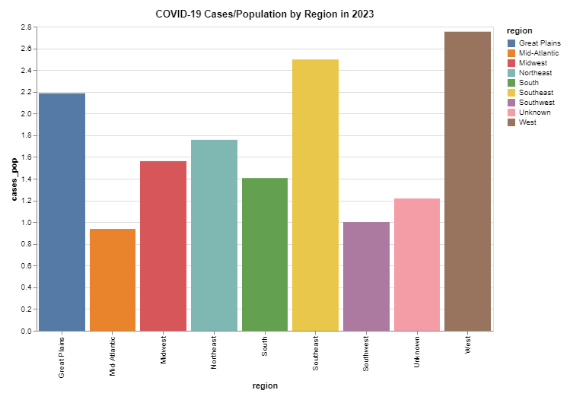
Graph #7: Histogram of Covid-19 deaths/cases by region 2023

Slide 20
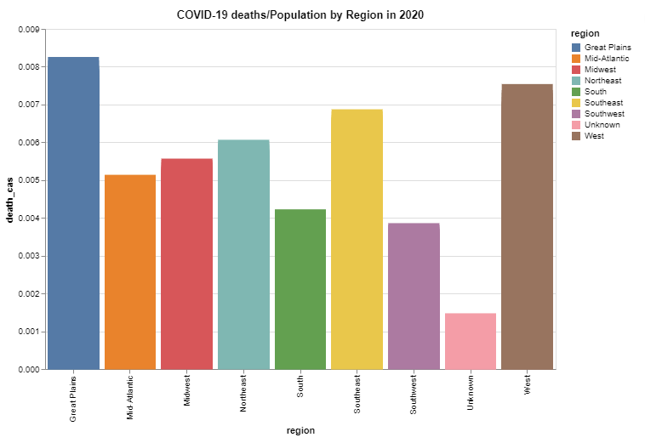
Graph #8: Histogram of Covid-19 deaths/cases by region 2020

Slide 21
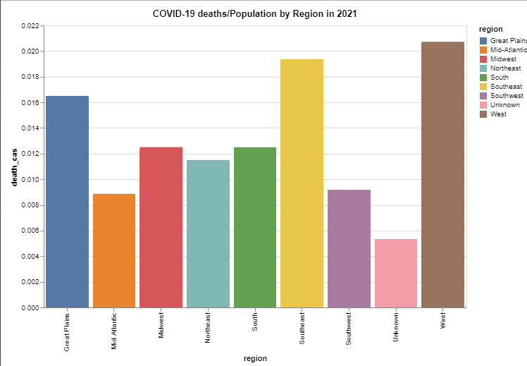
Graph #8: Histogram of Covid-19 deaths/cases by region 2021

Slide 22
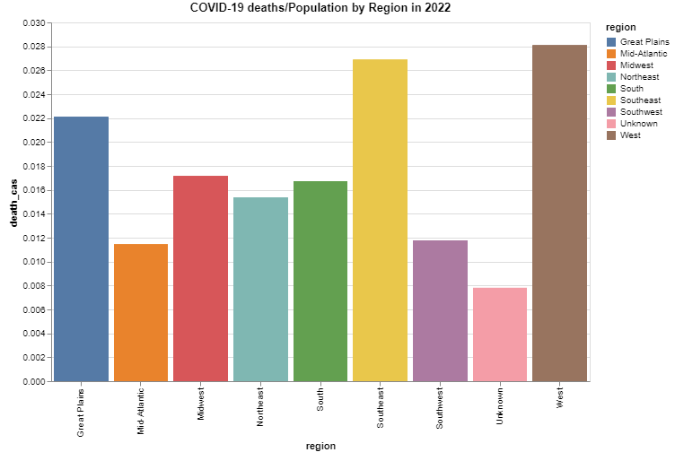
Graph #8: Histogram of Covid-19 deaths/cases by region 2022

Slide 23
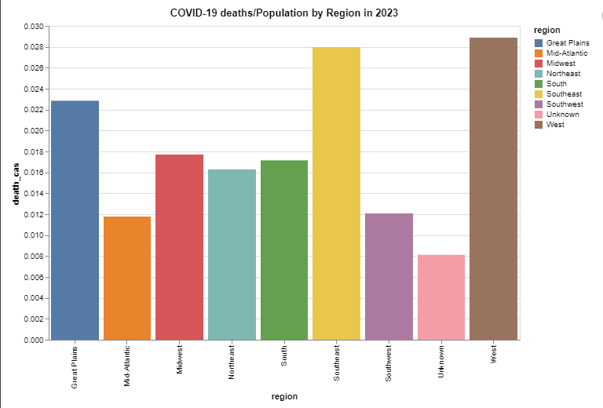
Graph #8: Histogram of Covid-19 deaths/cases by region 2023

